Slide 1
Systems Heuristics and Rigidity
Tools to help you map

Slide 2
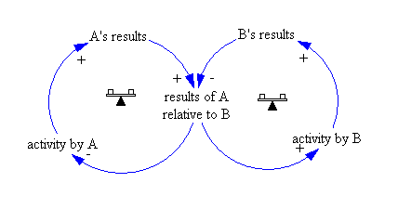
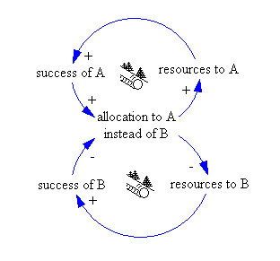
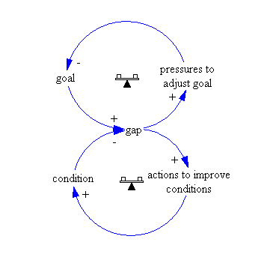
Heuristics - Reminder (I)
Escalation: while A & B grow/shrink, they stay relatively the same to each other
Eroding goals: you are unable to address a problem so you adjust your goal down
Success to success: two R loops, same starting conditions

Slide 3
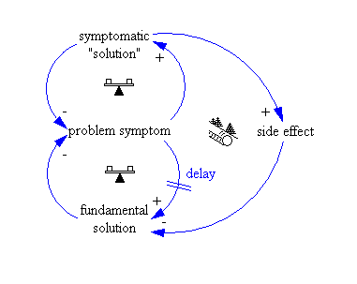
Heuristics - Reminders (II)
Shifting the Burden: you address symptoms not root causes, which temporarily makes things better. But as the root problem persists, a slow moving R loop can emerge, exacerbating problems and eroding trust.

Slide 4
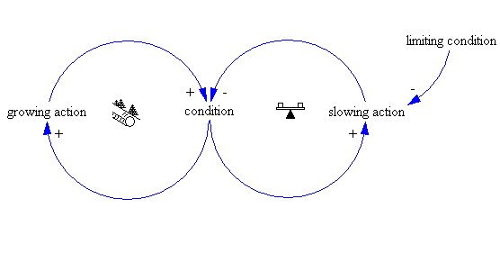
Heuristics - Reminders (III)
A bit of a new one, limits to growth has a R loop, but it can only grow so much, and a byproduct of R hits a limit (parameter), triggering a B loop, which then slows/cancels out the original R loop
Think, iPhone sales hitting market saturation and slowing Apple’s profit growth

Slide 5
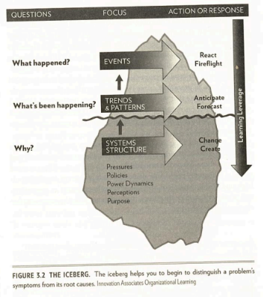
The Iceberg - Reminder!

